Slide 1
Karabük University
School of Foreign Languages
English Prep School
2021-2022 Academic Year
levels
important
about
follow
materials
assessment

Slide 2
English Prep School
An accredited member of EAQUALS
High quality program meeting international standards
materials
levels
about
important
follow
assessment
A modular system offering English courses for students who are going to study at departments where medium of instruction is English

Slide 3
Period
Period
Period
Period
1
2
3
4
LEVEL 1 LEVEL 2
LEVEL 3
LEVEL 4
8 weeks
27 September
19 November
LEVEL 1
LEVEL 2
LEVEL 3
LEVEL 4
LEVEL 2
LEVEL 3
LEVEL 4
LEVEL 3
LEVEL 4
1 week break
8 weeks
29 November
21 January
8 weeks
7 February
8 April
8 weeks
11 April
8 June
Term Break
important
1 week break
about
follow
materials
levels
assessment
24 January-4 February Term Break

Slide 4
Level Average: Pass & Fail
Those who successfully complete Level 4 will complete the preparatory program.
levels
important
about
follow
materials
assessment
Midterm
Class Performance
LAB
End of Level Test
% 30
% 10
% 50
Listening
Reading
Use of English
Writing
% 10
Listening
Reading
Use of English
Writing
Speaking
Online LAB studies
Participation
in class activities & discussions
Assignments
Those who fail due to absenteeism (F1) repeat studying the same level regardless of their success at exams.

Slide 5
You cannot attend classes without materials. Those who do not obtain online program passwords cannot attend LAB classes.
EAP
EAP
EAP
EAP
levels
important
materials
about
follow
assessment
Navigate A2-Elementary
OXFORD
Navigate B1
Pre-intermediate
OXFORD
Q Skills for Success 3 3rd Edition
OXFORD
Q Skills for Success 4 3rd Edition
OXFORD
LEVEL 1
LEVEL 2
LEVEL 3
LEVEL 4
Reading & Writing
Listening Speaking
Reading & Writing
Listening & Speaking
Students have to obtain original licensed materials; otherwise the student is responsible himself/herself for legal actions taken against university administration.

Slide 6
Absenteeism
Lab Courses
You are entitled to 35 hours of absence from a course. Those who exceed this limit repeat the relevant level regardless of their success.
Students are responsible for keeping their own attendance records.
The administration and/or lecturers do not have the authority to give you permission for any reason (excuses such as travel, illness, etc.). Use your absence for such urgent and important situations.
Medical reports are not deducted from absenteeism (except for committee reports for cases requiring treatment for 20 days or more)
The results of the studies you will do on the programs will affect your average rate by 10%. That's why it's important to get the original sources that contain the Online platform password.
Materials
Those who do not have the material such as coursebooks, workbooks cannot attend the course. Photocopy or pirated publications are prohibited.
levels
important
about
Follow
materials
assessment
Lateness
You must attend class on time. Latecomers will not be admitted to class/exams.

Slide 7
SFL Student Affairs: Ground floor no 9
International Students
KBU International Students Office
Student certificate
Document for completing Prep Program
Petitions for personal issues
Make up exam
Rejection to exam results (You must apply within 3 working days after results are announced)
Suspending Registration & Disenrollment
Issues regarding suspended students
Issues about fees
SFL Coordinators & Head of Department
KBU Directorate of Information Technology
Problems or questions about academic issues
levels
Where to go?
about
follow
materials
Problems about karabuk.edu.tr mail accounts
Problems about the Internet access in the campus
Student ID Cards
assessment
Instructors & Graders
Directorate of Student Affairs: SFL Building Entrance B
Problems or questions about academic issues
Feedback on midterm
Feedback on tasks and evaluation of in-class studies
Follow the Office hours.
Suspending Registration & Disenrollment
Issues regarding suspended students
Issues about fees

Slide 8
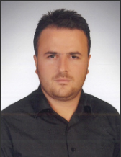
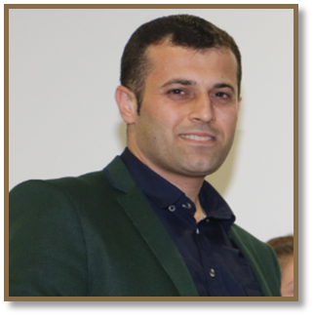
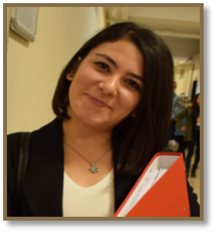
levels
Management
about
follow
materials
assessment
Asım AYDIN
Sami AKGÖL
Tuğba AKBAŞ
Director of School of Foreign Languages
Office no: 4
Vice Director of School of Foreign Languages
Vice Director of School of Foreign Languages
Administrative Affairs
Office no:8
Academic Affairs
Office No: 2

Slide 9
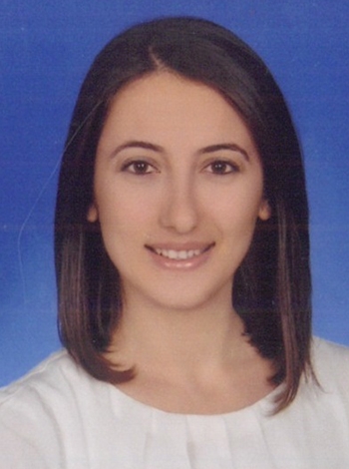
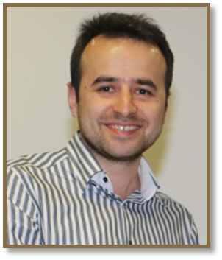
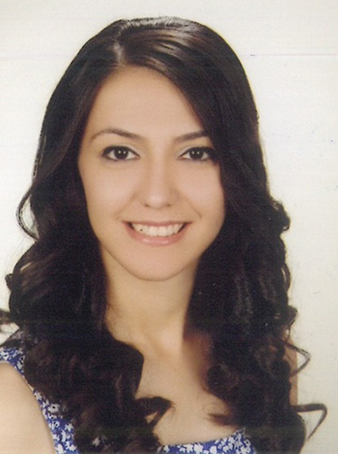
levels
Management
about
follow
materials
assessment
Tuğba YILDIRIM KARAKURLUK
Uğur TURAN
Sema Çetin
School of Foreign Languages
Vice Head of Department
School of Foreign Languages
Vice Head of Department
School of Foreign Languages
Head of Department

Slide 10
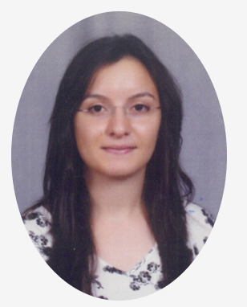
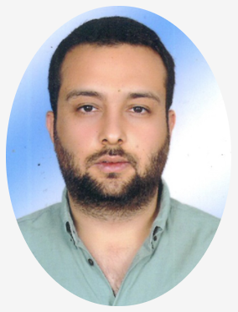
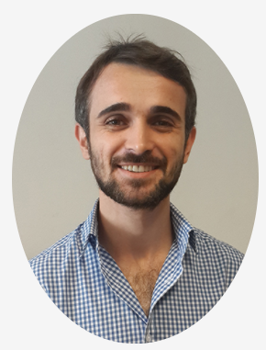
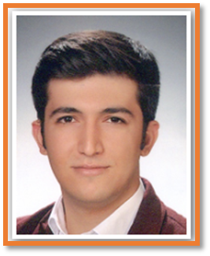
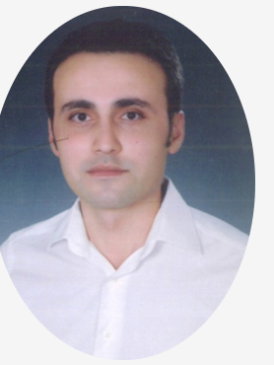
Büşra ŞANLI AKÇİN
Saycan Bora ERDOĞAN
Okan DEDE
LEVEL 1 Coordinator
Level 3 Coordinator
Level 2 Coordinator
Levels
Coordinators
About
Follow
Materials
Assessment
Enes TAŞDELEN
Mustafa POLAT
Level 4 Coordinator
Private Language Courses Coordinator

Slide 11
sfl.karabuk.edu.tr
@kbusfl
@ydyokbu
@kbuprep
@ydyokbu
levels
important
about
follow
materials
assessment

