Slide 1
Karabük University
School of Foreign Languages
English Preparatory Program
2023-2024 Academic Year
Evaluation
Attention
Follow Us
Program
Periods
Resources

Slide 2
English Preparatory Program
High-Quality Language Education Program in International Standards
Periods
Program
Follow Us
Evaluation
Sources
Attention
The program consists of a modular system aimed at meeting the needs of students in English-medium departments and enhancing their language proficiency and academic skills.

Slide 3
Period
Period
Period
Period
1
2
3
4
1. Level
2. Level
3. Level
4. Level
7 week
2 October
17 Novem.
1. Level
2. Level
3. Level
4. Level
8 week
27 Novem
19 Jan.
2. Level
3. Level
4. Level
8 Week
12 Feb.
5 April
3. Level
4. Level
8 week
15 April
7 June
1 WEEK BREAK
TERM BREAK
1 WEEK BREAK
Periods
Follow Us
Program
Sources
Evaluation
Attention
22 January – 9 February 2024
Term Break

Slide 4
Course Completion
The students who successfully complete Level 4 will have completed the preparatory program.
Evaluation
Periods
Sources
Program
Follow Us
Attention
Midterm
Student Portfolio
Online Activities
In-Class Performance
End-of-Level Exam
%30
%10
%10
%10
%40
Listening
Reading
Writing
Grammar
Vocabulary
Writing Activities
Speaking Activities
Online Activities
Attendance
Grammar Use
Homework
Listening
Reading
Writing
Speaking
Grammar
Vocabularyi
Students who fail due to absenteeism (F1) retake the course regardless of their performance.

Slide 5
Students who do not have course materials will not be allowed into the course. Since students who have not obtained their online activity passwords cannot perform the activities, the evaluation result is calculated as 0.
Attention
Program
Periods
Follow Us
Sources
Evaluation
Empower
Second Edition
A1 Starter
CAMBRIDGE
Empower
Second Edition
A2 Elementary
CAMBRIDGE
Empower
Second Edition
B1 Pre-Intermediate
CAMBRIDGE
Empower
Second Edition
B1+ Intermediate
CAMBRIDGE
LEVEL 1
LEVEL 2
LEVEL 3
LEVEL 4
The use of pirated and non-original resources is prohibited. Otherwise, the student is responsible for covering any legal and financial sanctions and losses that may occur against the university in this regard.

Slide 6
Attendance
Online Activities
It is very important that you attend classes. If your absence in a level exceeds 36 hours, you will repeat the relevant level regardless of your success.
However, since the first period is 7 weeks, the absence limit will be 32 hours.
You are responsible for keeping your own attendance records.
The administration and/or faculty members do not have the authority to give you leave for any reason (excuses such as travel, illness, etc.). You can use your absence for such urgent and important situations.
Health reports are not deducted from absences. (Except for committee reports in cases requiring treatment for 20 days or more)
The results of your online activities will be added to your general academic average as additional points. Therefore, it is important to obtain original sources that contain the online platform password.
Punctuality
You must attend the classes on time. Those who are late will not be allowed into classes/exams.
Sources
Follow Us
Attention!
Periods
Program
Evaluation
Resources
Students who do not have lesson materials such as book, dictionary etc. cannot attend the classes. The use of pirated copies is prohibited.

Slide 7
Students who can obtain the required scores from the exams listed below will be considered sufficient in terms of English level. Thus, they will be able to graduate from the preparatory class by presenting their documents regarding these scores to the School of Foreign Languages.
KBU SFL Proficiency Exam
65
TOEFL IBT
75
Cambridge ESOL
(FCE/CAE/CPE)
C
Pearson
PTE
55
Attention
Follow Us
Program
Periods
Proficiency
Evaluation
ÖSYM
YDS /E-YDS 65
ÖSYM
YÖKDİL
65
IELTS
6.0
LANGUAGE
CERT

Slide 8
Students who are in a repeat situation have the right to take proficiency exams on the dates specified below.
Proficiency Exam I
18-19.01.2024
Repeat Students
Attention
Follow Us
Program
Periods
Evaluation
Proficiency Exam II
11-12.06.2024
Students should follow the instructions and announcements available on the School of Foreign Languages' (YDYO) website.

Slide 9
Prepschool Student Affairs
Ground Floor No: 9
International Student Coordination Office
Residence certificate for international students,
Certificate for Prep-Class graduation
Petitions for special circumstances
Make-up Exams
Objection to exam results (must be made in the following 3 work-days after the announcement of the grades)
Registration freezing or deletion procedures,
Status changes for international students on leave,
Fee-related matters for international students
Information Processing Department
Rectorate Building
Department Heads and Coordinators of SFL
Sources
Follow Us
Evaluation
Program
Academic questions and problems
What & Where?
Periods
Problems with karabuk.edu.tr extension
In-campus internet access issues
Student Identity Cards(Student Affairs + Ziraat Bank)
Student Affairs Office
Instructors and Supervisors
Student Certificates
Procedures for freezing or deleting registration
Status changes for students on leave
Fee-related matters
Academic questions and problems
Feedback for midterm exams
Evaluation and feedback processes of in class activities
Office hours

Slide 10
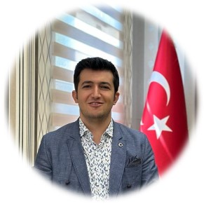
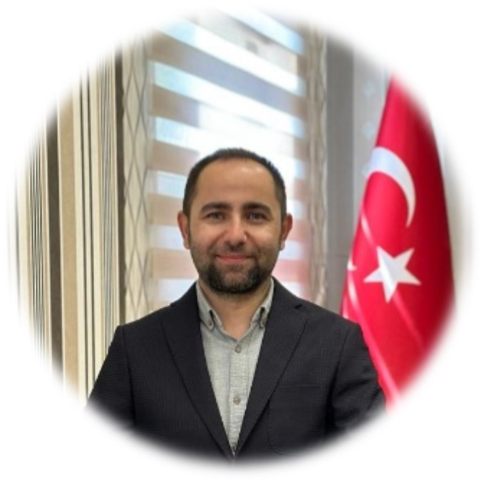
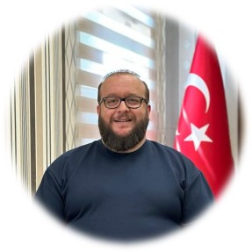
Follow Us
Evaluation
Periods
Administration
Program
Sources
Asst. Prof. Dr. Mustafa POLAT
The Director of the School of Foreign Languages
Office No: 4
Lecturer
Kürşat ARSLAN
Vice Manager of the School of Foreign Languages
Administrative Affairs
Office No: 8
Lecturer
Hüseyin ATASEVEN
Vice Manager of the School of Foreign Languages
Academic Affairs
Office No: 2

Slide 11
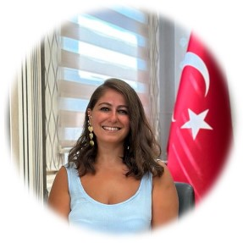
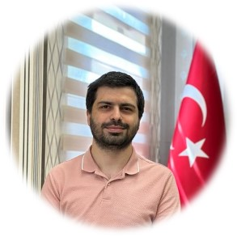
Evaluation
Follow Us
Sources
Periods
Administration
Program
Asst. Prof. Dr. Mustafa POLAT
Lecturer
Nazan CANBULAT
Lecturer
Şâkir AŞÇI
School of Foreign Languages Department Chair
Office No:4
Vice-head of the School of Foreign Languages
Office No: 3
Vice-head of the School of Foreign Languages
Office No: 3

Slide 12
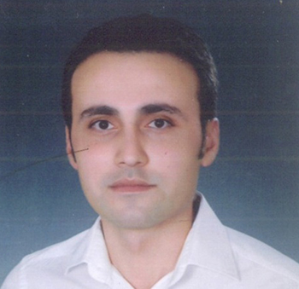
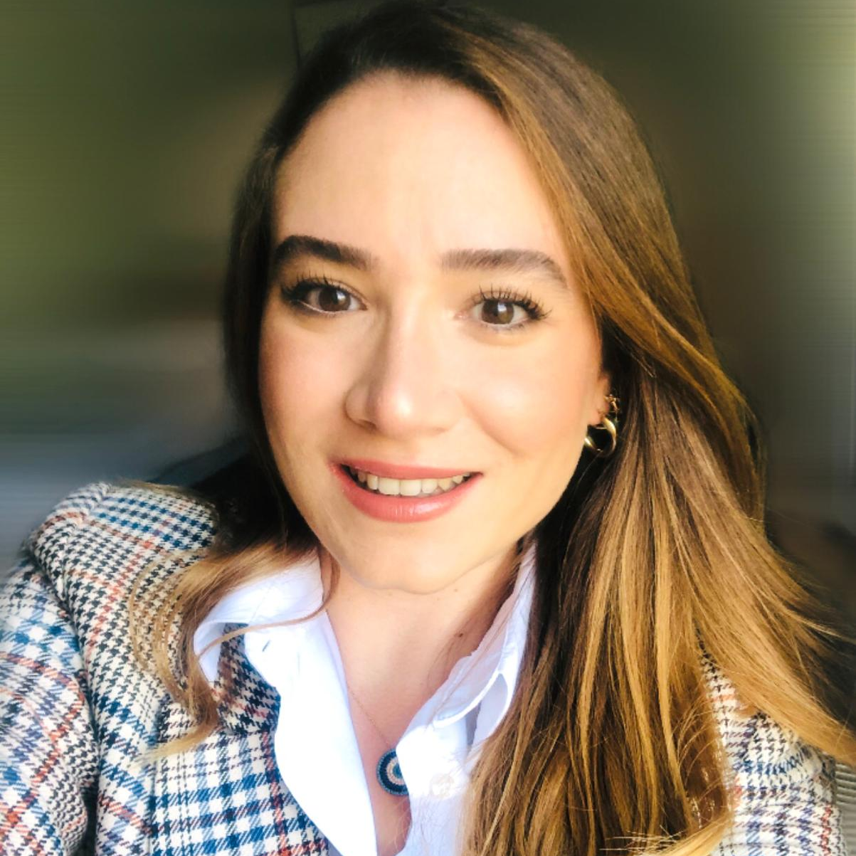
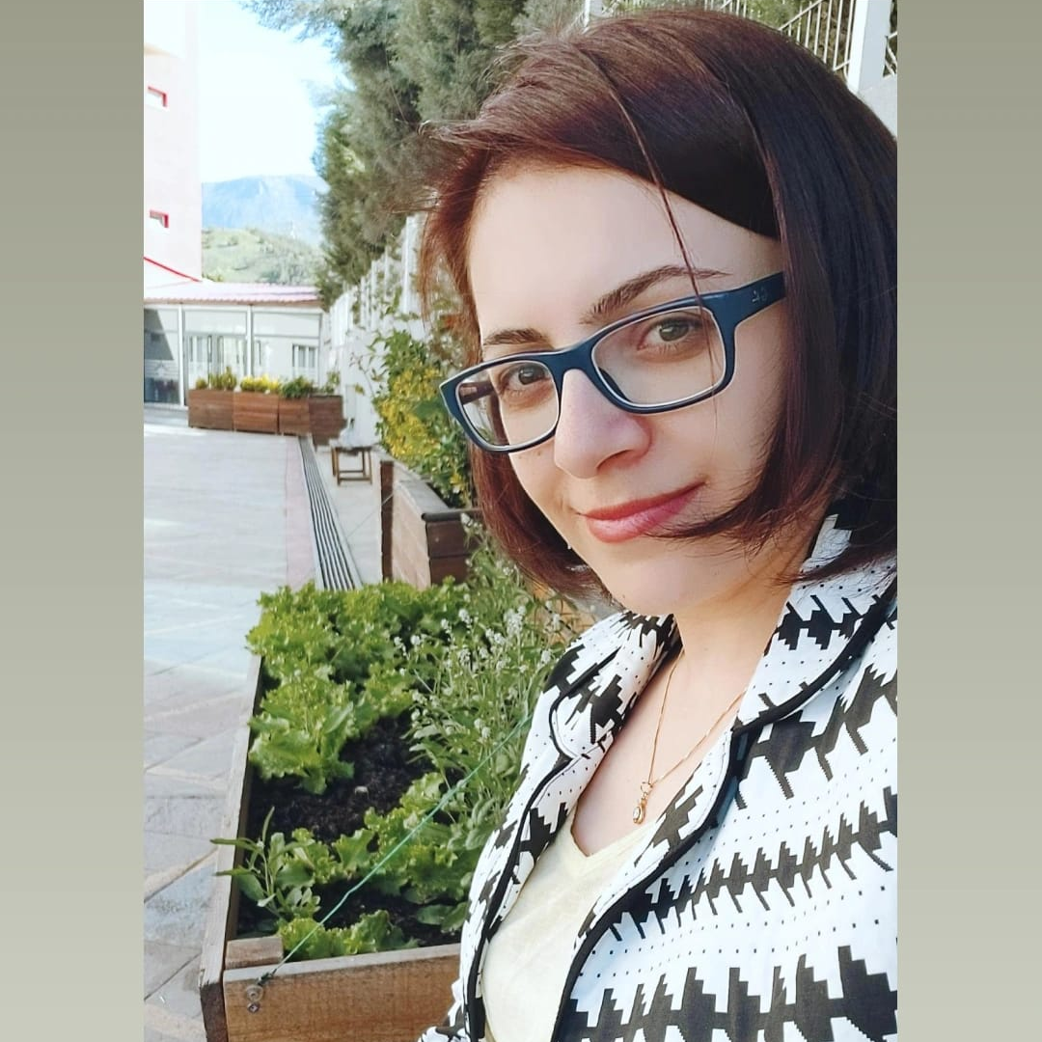
Curriculum and Materials Coordination Office
Ayça Gülünay
Unit Coordinator
Kaynaklar
Program
Periods
Follow Us
Evaluation
Coordinators
Enes Taşdelen
Gözde Begüm Mızrak
Selma Parlakay Topbaş
Zeynep Gözde Güven Lüleci
Level Coordinator
Level Coordinator
Level Coordinator
Level Coordinator

Slide 13
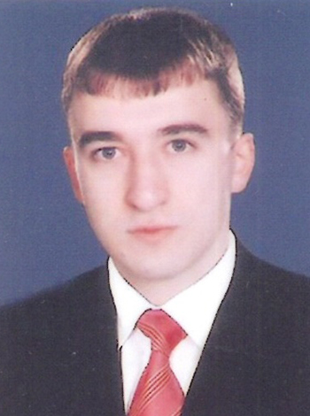
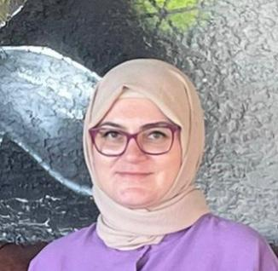
Other Unit Coordinators
Sources
Program
Coordinators
Periods
Follow Us
Evaluation
İsmail Tekşen
Pelin Şık
Self-Access Center Coordinator
(Bağımsız Öğrenme Merkezi)
Coordinator of Courses

Slide 14
Self Access Center
Sources
Program
Periods
Follow Us
Evaluation
Self Access Center
We invite all our students to contribute to their future with the opportunities we offer at our center. Visit our center and gain a new experience for your language education.

Slide 15
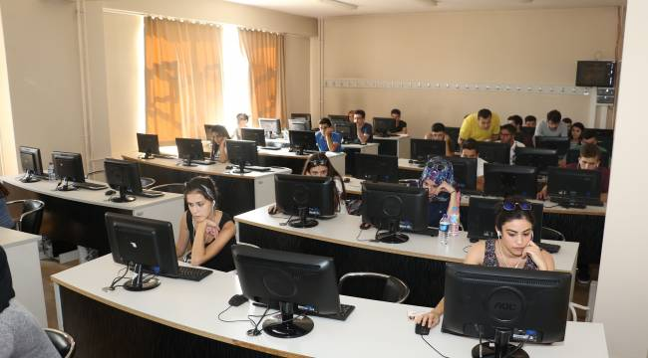
Computer Laboratories
Resources
Program
Periods
Follow Us
Evaluation
Laboratories
In addition, students who do not have internet access can use the language laboratory 114 in the School of Foreign Languages ​​building to complete their online activities.

Slide 16
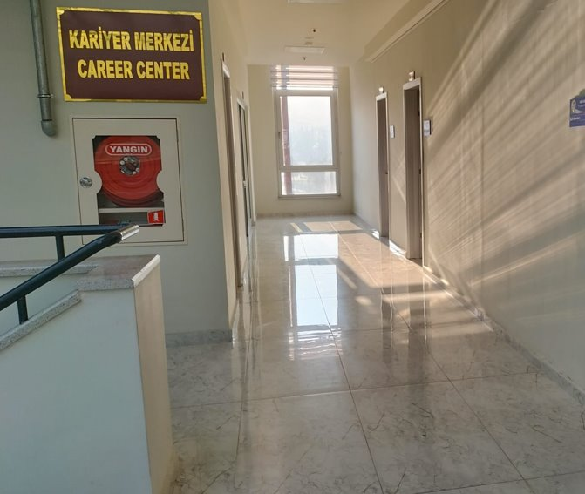
Career Center
Career Center
Resources
Program
Periods
Follow Us
Evaluation
Career Center aims to create career awareness for students from the moment they enter the university, guide them in developing their interests and skills, and assist them in making career plans.
https://kariyer.karabuk.edu.tr

Slide 17
sfl.karabuk.edu.tr
Evaluation
Sources
Periods
Attention
Program
Follow us!
kbusfl
kbusfl
kbusfl

Slide 18
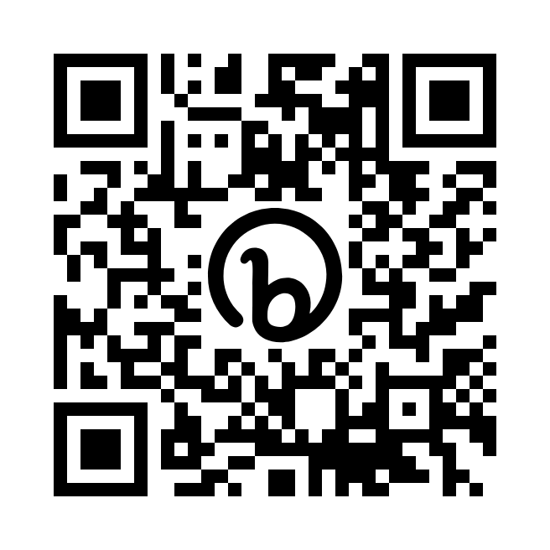
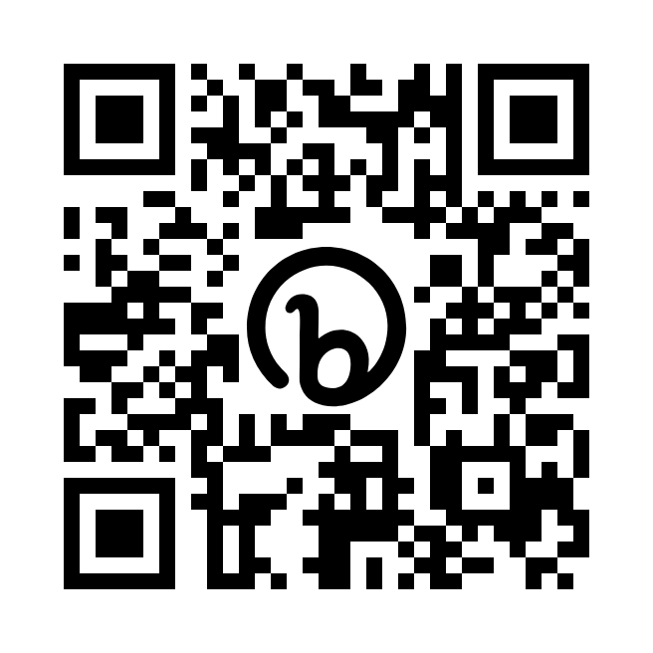
Frequently Asked Questions
Evaluation
Sources
Periods
Attention
Program
QR Codes
Turkish http://bit.ly/sflsorucevap
English http://bit.ly/sflquestions

Slide 19
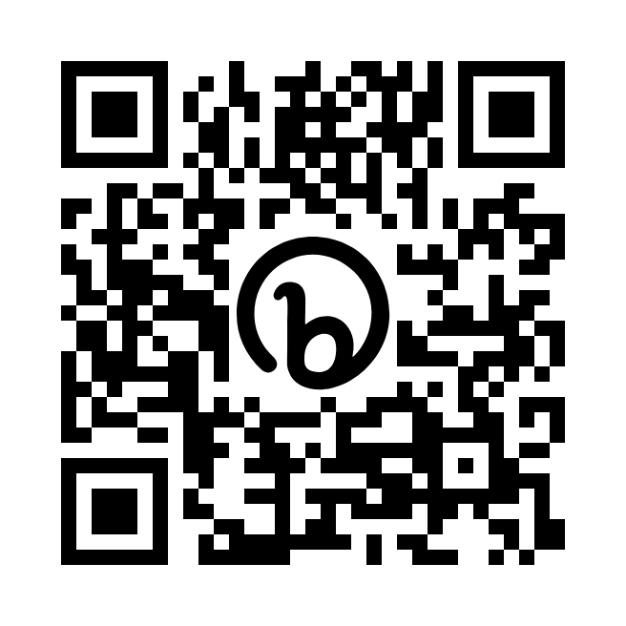
Ask us!
Evaluation
Sources
Periods
Attention
Program
QR Code
http://bit.ly/sflsoru

